Slide 1
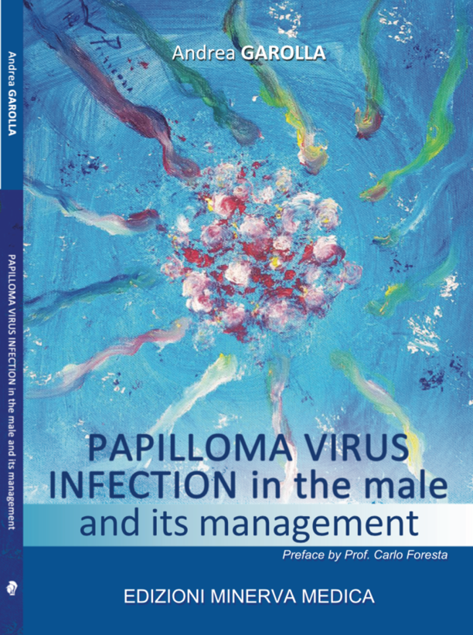
PAPILLOMA VIRUS INFECTION IN THE MALE AND ITS MANAGEMENT
Index
Biology and pathogenesis of human papillomaviruses
Epidemiology of HPV infection
Mechanisms of viral infection and transmission
Risk factors and prevention
Where to search HPV in the male?
Symptoms, warts and genital lesions
Oropharyngeal localization
HPV related cancers
Semen infection
Detection of semen HPV by FISH HPV and miscarriages
HPV and miscarriage
Treatment of infected sperm for assisted reproduction
Treatment of genital lesions
Treatment of anal lesions
Treatment of oropharyngeal lesions
Counselling and management of infertile couples
Anti-HPV antibodies
Circulating HPV
HPV vaccination
Impact of vaccination on genital manifestations and fertility
Gynaecologist’s point of view
segreteria@fondazioneforestaonlus.it

Slide 2
